Slide 1
Data Analysis Job
Which job in Data Science should one target and what skills must you have

Slide 2
Today’s Agenda
Project recap
Problem
The Analytics team
Process
Insights
Summary

Slide 3
Project Recap
In this project, I analyzed a comprehensive dataset containing job requirements across multiple data-related roles, including Data Analyst, Data Scientist, Data Engineer, BI Analyst, Machine Learning Engineer, and other emerging data careers. The goal was to understand skill demands, role patterns, and the relationship between technical competencies and job categories

Slide 4
Problem
The job requirement dataset was unstructured, containing varied formats of skills, tools, and job descriptions.
The problem was to clean, standardize, and analyze the dataset to extract meaningful insights about job categories, required skills, and hiring trends.

Slide 5
The Analytics Team
Luke Barousse – Senior Principal Data Analysis
Moses Macharia – Data Analyst

Slide 6
Process
Data Understanding
Data Cleaning
Data Modelling
Data Analysis

Slide 7
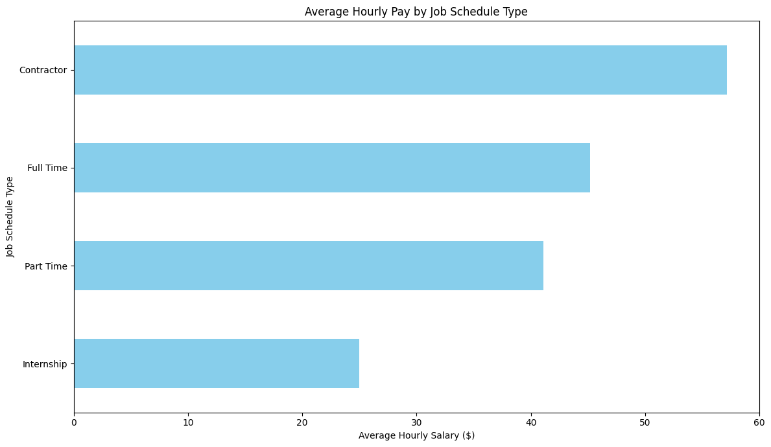
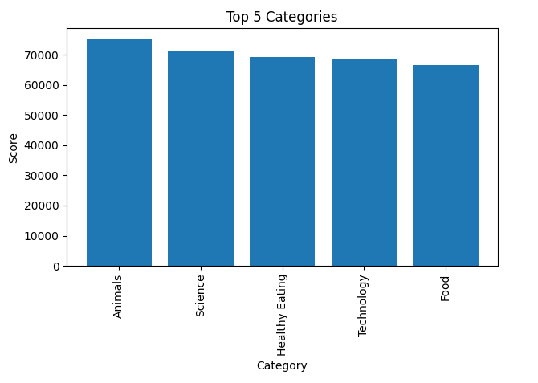
INSIGHTS: Top 5 Categories

Slide 8
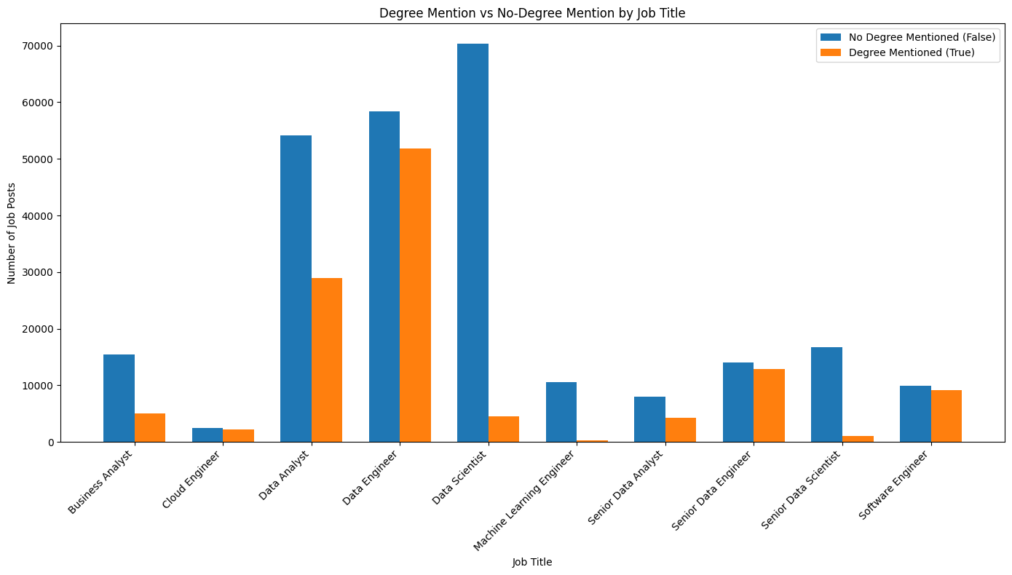
How many unique categories are there?
There are 16 categories
Studying
Healthy Eating
Technology
Food
Cooking
Dogs
Soccer
Public Speaking
Science
Tennis
Travel
Fitness
Education
Veganism
Animals
Culture

Slide 9
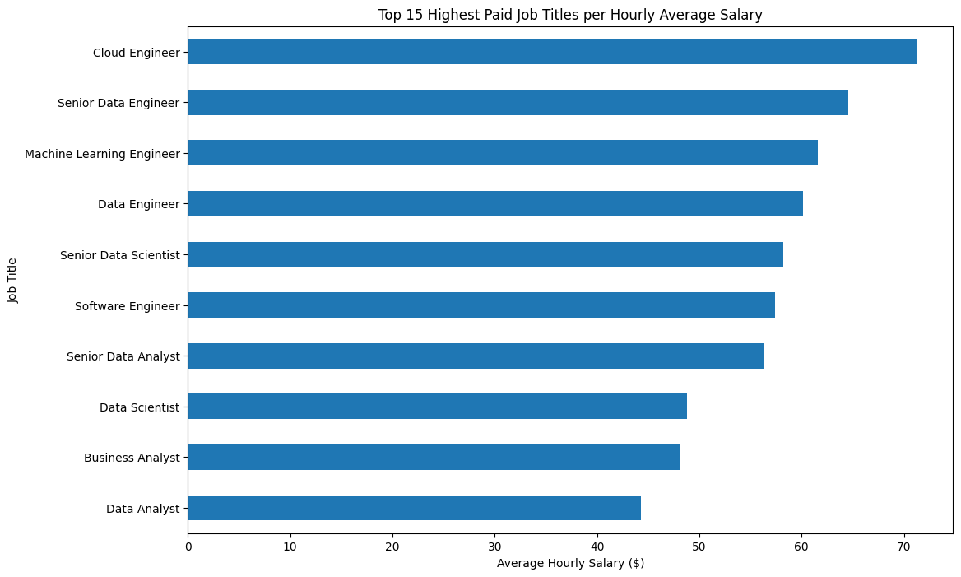
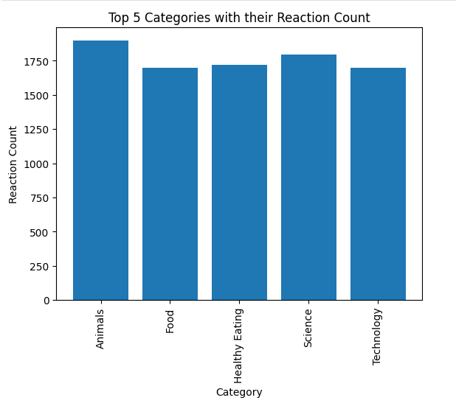
INSIGHTS: Top 5 Content Categories with their Reaction Count

Slide 10
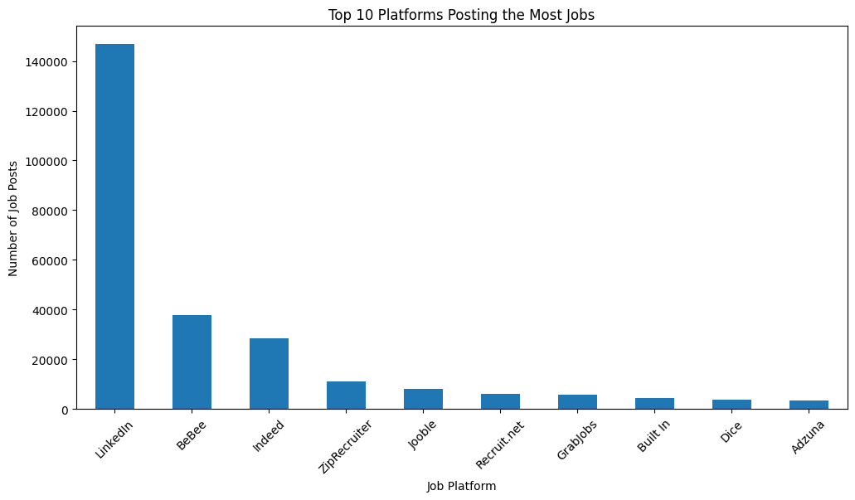
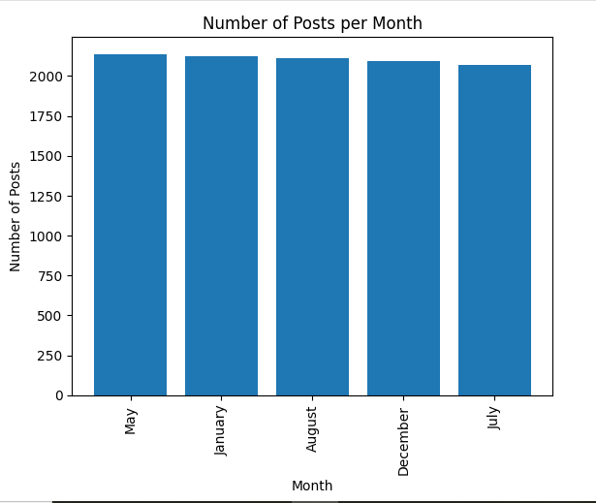
What was the month with the most posts?
The month with the most posts is the month of May.

Slide 11
